Slide 1
Introduction To Programming
C++, OOP and the Command Pattern

Slide 2
C versus C++
C (Developed 1969) | C++ (Developed 1979)
C is a subset of C++. | C++ is a superset of C.
32 Keywords | 63 Keywords
Procedural programming | Procedural and Object Oriented Programming
C does not support information hiding | Information is “hidden” via encapsulation – (data and functions are hidden in namespaces to avoid collision using visibility modifiers)
Function driven | Object driven
Commonly compiled using gcc | Commonly compiled using g++
Does not support polymorphism encapsulation and inheritance | Supports polymorphism, encapsulation and inheritance
Functions can not be defined inside structures | Functions can be used inside structures
Header used: stdio.h | Header used: iostream.h

Slide 3
Hello, C++
“g++ -o out *.cpp” – run to compile all cpp source files in the directory.
Instead of printf and scanf lets use std::cin and std::cout

Slide 4
Class and Object
Object oriented programming is a way of thinking about programming. It is a very common methodology in games and other commercial applications. In OOP, you define classes and relationships between them and rules for interaction between objects. Think of Classes as blueprints for objects - Eg if you would have a player class, its data members would be lives, and member functions would be anything a player can do. Classes are similar to C Structs, with the exception, that classes can also define behavior.

Slide 5
Object-Oriented Programming terms
Inheritance – Classes can be derived from more general base classes. (Eg Enemy base class and RookeyWhelpEnemy as the subclass) In doing so, they inherit the data members and member functions from their base class.
Polymorphism – The ability for multiple classes to derive from one base class. (Many different types of enemies can all use the same Enemy base class – meaning functionality common to them does not need to be written multiple times)
Encapsulation – data members and member functions can be hidden from being available outside of a class (only code from that class can use it) It is a useful technique for Clean Code architecture
Interface - a “Contract” between developers, which defines how common functionality will be implemented.

Slide 6
SOLID Programming
The Single Responsibility Principle - a class should do one thing and therefore it should have only a single reason to change.
The Open-Closed Principle - classes should be open for extension and closed to modification.
The Liskov Substitution Principle - subclasses should be substitutable for their base classes.
The Interface Segregation Principle - Segregation means keeping things separated, and the Interface Segregation Principle is about separating the interfaces. The principle states that many client-specific interfaces are better than one general-purpose interface. Clients should not be forced to implement a function they do no need.
The Dependency Inversion Principle - The Dependency Inversion principle states that our classes should depend upon interfaces or abstract classes instead of concrete classes and functions.

Slide 7
The Command Pattern
”The Command Pattern is a particularly flexible and powerful design pattern. able to streamline decision making and selection by doing something that most object-oriented languages don't naturally do - treating operations or commands as objects in their own right, allowing related commands to be grouped together and picked out at runtime, without a tedious If/then/else structure.” - https://www.dreamincode.net/forums/topic/38412-the-command-pattern-c/
It is very commonly used in games to trigger behaviors in NPC entities, pass player actions, represent different kinds of spells etc.

Slide 8
The command pattern example.
To illustrate the aim of object oriented programming, we will be looking at an existing example written for windows, and reimplementing it to be platform-agnostic and run on command line. The project is a calculator and the source is also available in the lecture materials. - 1
1. https://www.codeproject.com/Articles/343676/Understanding-and-Implementing-the-Command-Pattern (08.05.2022)

Slide 9
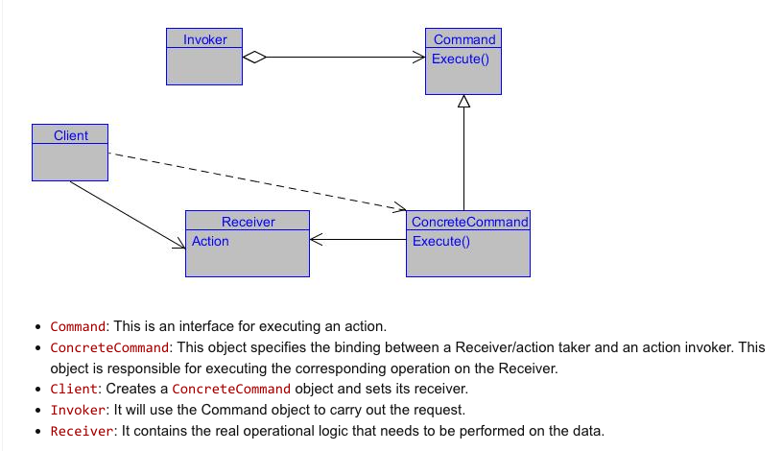
Relationship definition

Slide 10
Command Pattern calculator
Our aim will be to take an existing project (from: https://www.codeproject.com/Articles/343676/Understanding-and-Implementing-the-Command-Pattern) And reimplement it to support command line

